Slide 1
Percentage of Provider Contracts Currently Tied to VBC
FIGU RE 1
0% | 1-10% | 11-20% | 21-30% | 31-40% | 41-50% | 50+%
2% | 9% | 16% | 26% | 22% | 20% | 5%
 |  |  |  | 73%
SOURCE: Results from a survey conducted by Wakefield Research of 100 U.S. executive decision-makers with a minimum seniority of VP at health plans (payers) between May and June 2026. Results are subject to sampling variation. Full explanation of survey methodology available at www.cedargate.com/the-path-forward-for-value-based-care-payer-success

Slide 2
VBC Initiatives and Alternative Payment Models Organizations are Actively Engaged in Now, or Planning to Pursue
FIGU RE 2
Quality Programs with Upside Incentives Only
68%
Bundled Payments (Episodes of Care)
64%
Primary Care Attribution with Upside Incentives Only
49%
Two-Sided (Upside and Downside) Risk
40%
Partial Capitation
30%
Global Capitation
23%
No Current Initiatives and no Plans to Pursue any VBC Initiatives or Alternatives
0%
SOURCE: Results from a survey conducted by Wakefield Research of 100 U.S. executive decision-makers with a minimum seniority of VP at health plans (payers) between May and June 2026. Results are subject to sampling variation. Full explanation of survey methodology available at www.cedargate.com/the-path-forward-for-value-based-care-payer-success

Slide 3
Top Three Factors Ranked for Successfully Implementing and Scaling VBC Within Organization
FIGU RE 3
Technology Platforms Built Specifically for VBC
62%
Advanced Analytics and Data Capabilities
53%
Coordination and Alignment with Providers
51%
Internal Operational Readiness
47%
Financial Risk Modeling Capabilities
44%
Regulatory Clarity and Stability
43%
SOURCE: Results from a survey conducted by Wakefield Research of 100 U.S. executive decision-makers with a minimum seniority of VP at health plans (payers) between May and June 2026. Results are subject to sampling variation. Full explanation of survey methodology available at www.cedargate.com/the-path-forward-for-value-based-care-payer-success

Slide 4





Agree or Disagree: We Are Not Currently Achieving the Cost and Quality Outcomes Expected from Our VBC Programs and Initiatives.
FIGU RE 4
83%
39%
44%
15%
Agree strongly Agree somewhat Disagree somewhat Disagree strongly
N/A - We do not have any current value-based care programs or initiatives 2%
0%
SOURCE: Results from a survey conducted by Wakefield Research of 100 U.S. executive decision-makers with a minimum seniority of VP at health plans (payers) between May and June 2026. Results are subject to sampling variation. Full explanation of survey methodology available at www.cedargate.com/the-path-forward-for-value-based-care-payer-success

Slide 5
Top Constraints on Organization’s Ability to Effectively Participate in VBC Contracts
FIGU RE 5
Lack of integrated analytics and care management applications
47%
Poor data quality, fragmented data, and/or data disparities across multiple systems
47%
Lack of access to near-real-time data
45%
Lack of clinical data from provider electronic health record systems (EHRs)
44%
Limited access to market-level data for benchmarking and trend analysis
42%
Limited or no ability to collaborate with provider partners in their workflows
31%
Provider partners lack technology to effectively manage risk in care delivery
26%
Confusing or changing metrics
24%
Nothing constrains our ability to participate in value-based care contracts
2%
Other
0%
SOURCE: Results from a survey conducted by Wakefield Research of 100 U.S. executive decision-makers with a minimum seniority of VP at health plans (payers) between May and June 2026. Results are subject to sampling variation. Full explanation of survey methodology available at www.cedargate.com/the-path-forward-for-value-based-care-payer-success

Slide 6


Current Interoperability Challenges Negatively Impact Participation and Performance in VBC Programs
FIGU RE 6
8
5
%
42%
43%
15%
Agree Strongly
Agree Somewhat
Disagree Somewhat
Disagree strongly 0%
SOURCE: Results from a survey conducted by Wakefield Research of 100 U.S. executive decision-makers with a minimum seniority of VP at health plans (payers) between May and June 2026. Results are subject to sampling variation. Full explanation of survey methodology available at www.cedargate.com/the-path-forward-for-value-based-care-payer-success

Slide 7


Organization’s Level of Current Technology to Support the Expansion or Advancement of VBC Models
FIGU RE 7
20%
24%
Fully Equipped
Mostly Equipped
Somewhat Equipped
Not Very Equipped 0%
Not at All Equipped 0%
7
6
%
56%
SOURCE: Results from a survey conducted by Wakefield Research of 100 U.S. executive decision-makers with a minimum seniority of VP at health plans (payers) between May and June 2026. Results are subject to sampling variation. Full explanation of survey methodology available at www.cedargate.com/the-path-forward-for-value-based-care-payer-success

Slide 8
Impact of Limited Access to Near-Real-Time Performance Data on VBC Contract Management
FIGU RE 8
It creates major delays or bottlenecks in managing contracts
64%
It impacts our ability to adjust performance throughout the year
57%
It limits our ability to ensure appropriate interventions for members
54%
It leads to more uncertainty in decision making
50%
It causes confusion or misalignment across teams or partners
39%
Limited access to near-real-time performance data does not impact us
0%
SOURCE: Results from a survey conducted by Wakefield Research of 100 U.S. executive decision-makers with a minimum seniority of VP at health plans (payers) between May and June 2026. Results are subject to sampling variation. Full explanation of survey methodology available at www.cedargate.com/the-path-forward-for-value-based-care-payer-success

Slide 9

Effectiveness of Collaboration with Provider Partners to Align on Risk and Execute VBC Program Goals
FIGU RE 9
4
9
%
51%
47%
Very Effectively
Somewhat Effectively
Not Very Effectively
Not at All Effectively 1%
SOURCE: Results from a survey conducted by Wakefield Research of 100 U.S. executive decision-makers with a minimum seniority of VP at health plans (payers) between May and June 2026. Results are subject to sampling variation. Full explanation of survey methodology available at www.cedargate.com/the-path-forward-for-value-based-care-payer-success

Slide 10

Confidence in Forecasting Financial Risk and Modeling Performance for VBC Contracts
FIGU RE 10
30%
50%
20%
Completely Confident
Very Confident Somewhat Confident
Not Very Confident or
Not at All Confident
0%
SOURCE: Results from a survey conducted by Wakefield Research of 100 U.S. executive decision-makers with a minimum seniority of VP at health plans (payers) between May and June 2026. Results are subject to sampling variation. Full explanation of survey methodology available at www.cedargate.com/the-path-forward-for-value-based-care-payer-success

Slide 11
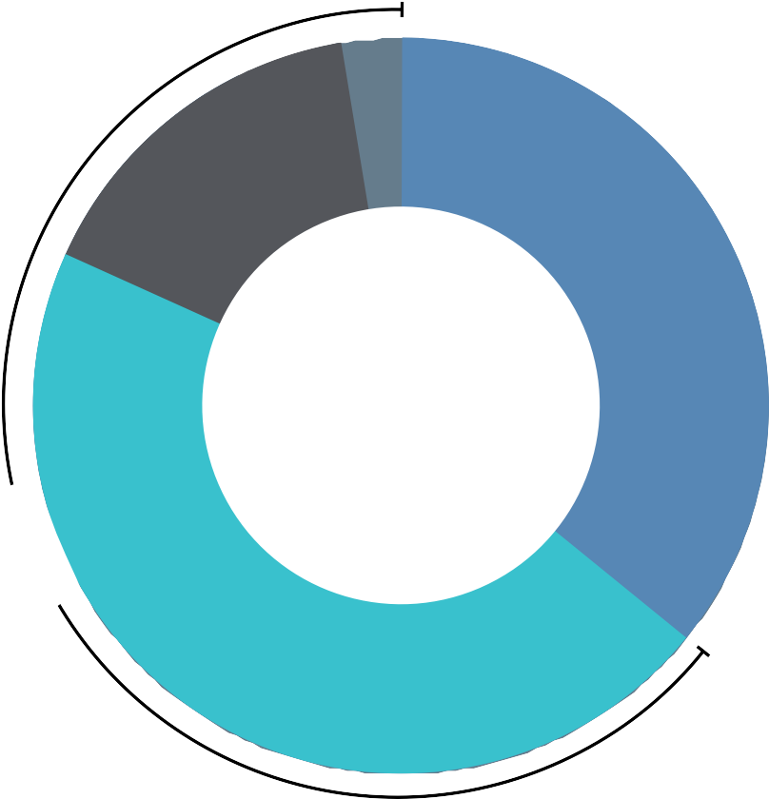

Preparation Level of Technology and Data Infrastructure to Support AI-Driven Decision Making in VBC
FIGU RE 11
2%
18%
Fully Prepared
Mostly Prepared
34%
Somewhat Prepared
Not Very Prepared
Not at All Prepared 0%
6
6
%
46%
SOURCE: Results from a survey conducted by Wakefield Research of 100 U.S. executive decision-makers with a minimum seniority of VP at health plans (payers) between May and June 2026. Results are subject to sampling variation. Full explanation of survey methodology available at www.cedargate.com/the-path-forward-for-value-based-care-payer-success

Slide 12
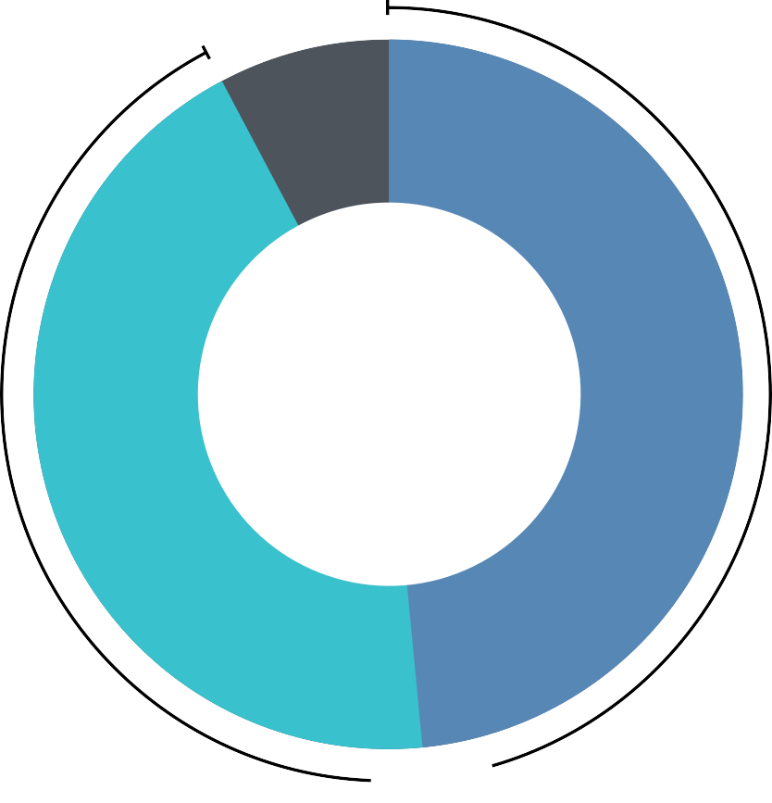
Not Having a Single, Connected Source of Data is a Major Barrier to Scaling AI use in VBC
FIGU RE 12
8%
Agree Strongly
Agree Somewhat
49%
Disagree Somewhat
Disagree Strongly 0%
43%
9
2
%
SOURCE: Results from a survey conducted by Wakefield Research of 100 U.S. executive decision-makers with a minimum seniority of VP at health plans (payers) between May and June 2026. Results are subject to sampling variation. Full explanation of survey methodology available at www.cedargate.com/the-path-forward-for-value-based-care-payer-success

